Slide 1
MUNICIPAL SOLID WASTE MANAGEMENT 18CEO306T UNIT III

Slide 2
CONTENTS
Waste Collection, Storage and Transport
Methods of solid wastes collection
Analysis of collection system
Collection Components
Storage: Containers / Collection Vehicles
Tutorial5: Identify the suitable collection system for urban areas
Collection Operation
Movement of collection crew
Collection vehicle routing
Transfer station and their goals
Capacity and Viability
Waste Collection System Design
Record Keeping, Control, Inventory and Monitoring
Implementing Collection and Transfer System

Slide 3
WASTE COLLECTION, STORAGE AND TRANSPORT
WHY SOLID WASTE COLLECTION IS REQUIRED ?
Health of Citizens : Organic waste biodegrades quickly and releases pungent odours. The discharge of organic waste attracts flies, rats and other pests. These vectors spread diseases.
Environmental Sustainability: The water, air and physical environment have been affected due to bad management of solid waste.
Beauty of the Area: Improper solid waste management, not only threatens the natural beauty of water bodies, forest reserves, diversity-rich mountains and beaches but also cities and villages. Littering spoils the scenic beauty of the environment.
Economic Development : Cleaner cities are better able to attract private investments and tourists

Slide 4
COLLECTION COMPONENTS
Collection points
Collection frequency
Storage containers
Collection crew
Collection route (Routing/Network analyses)
Transfer station
Factors affecting collection frequency:
Cost/Storage space/Sanitation
Factors affecting storage:
Efficiency/Convenience/Compatibility/Public health and safety/Ownership

Slide 5
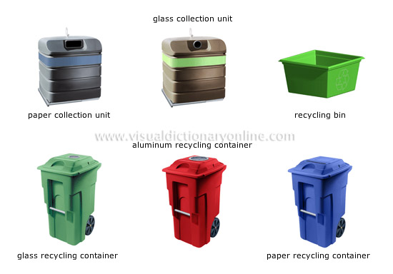
STORAGE: CONTAINERS/COLLECTION VEHICLES

Slide 6
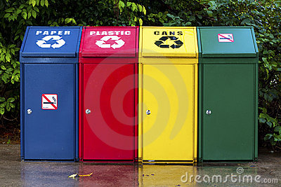
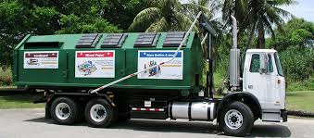
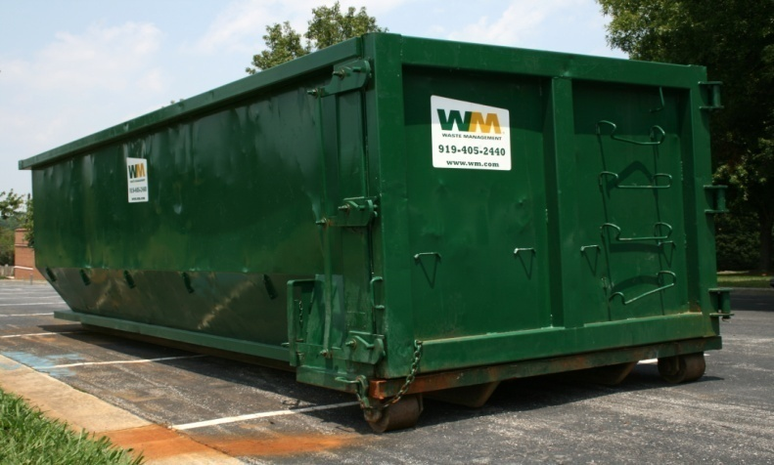
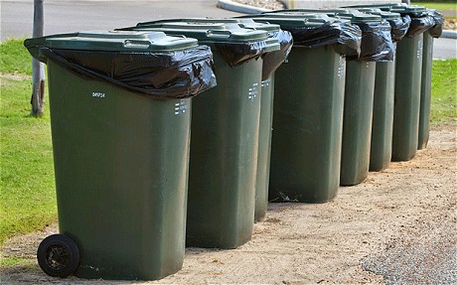
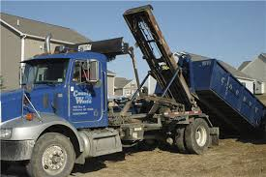
Stationary containers
Hauled containers
Communal containers

Slide 7
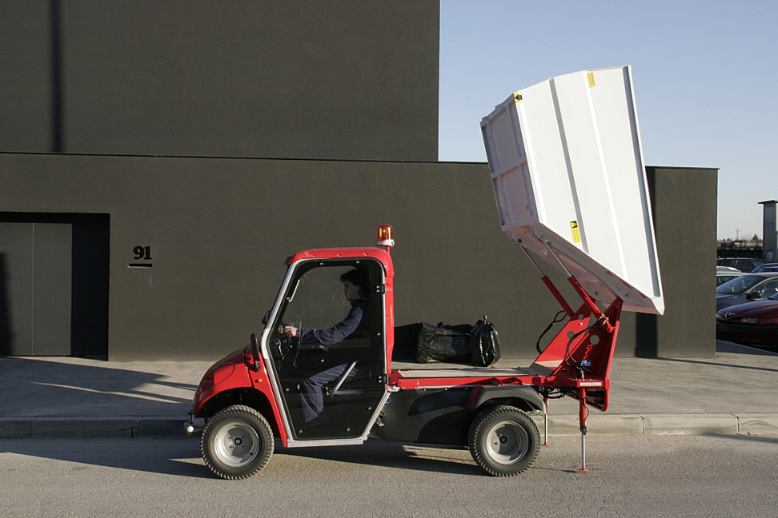
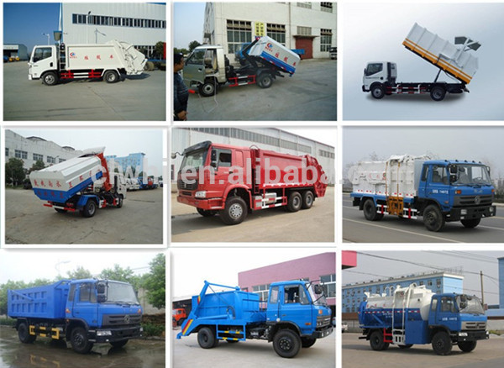
WASTE COLLECTION VEHICLES

Slide 8
TRANSFER STATION
A transfer station is a building or processing site for the temporary deposition of waste.
Transfer stations are often used as places where local waste collection vehicles will deposit their waste cargo prior to loading into larger vehicles. These larger vehicles will transport the waste to the end point of disposal in an incinerator, landfill, or hazardous waste facility, or for recycling.
Transfer stations are sometimes located with material recovery facilities and with localized mechanical biological treatment systems to remove recyclable items from the waste stream.

Slide 9
TYPES
1) Small to medium Transfer stations
100 to 500 tonnes per day
No storage area
2) Large transfer station
Direct discharge non-compaction station
Platform / pit non-compaction station
Compaction station
Capacity / Viability / Cost analysis

Slide 10
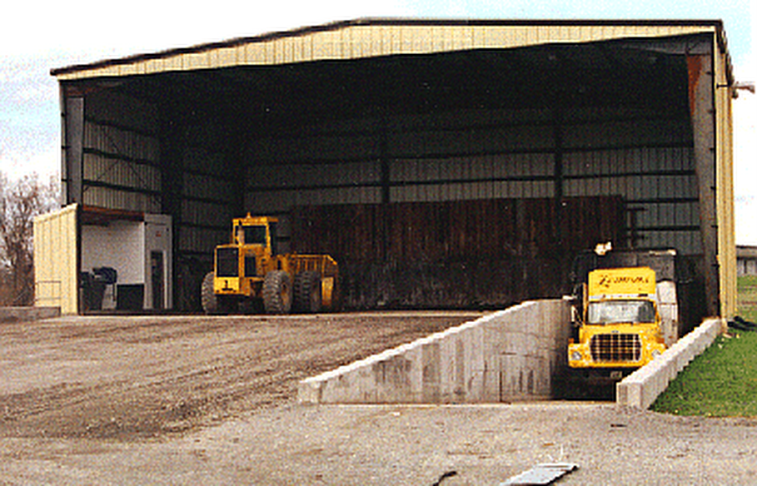
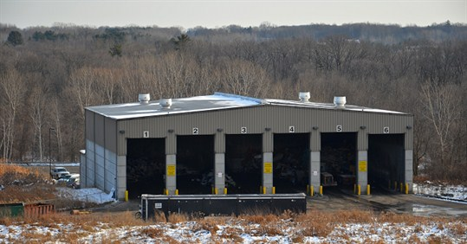

Slide 11
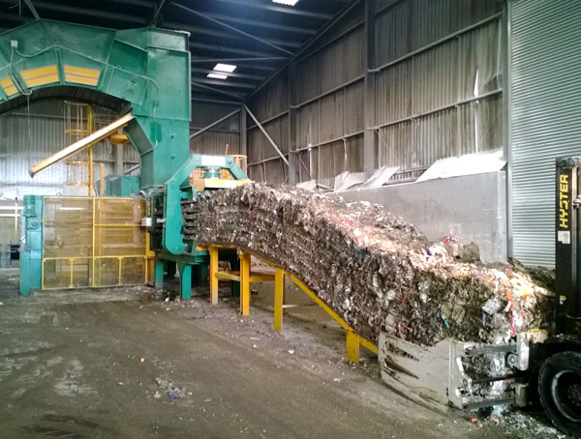

Slide 12
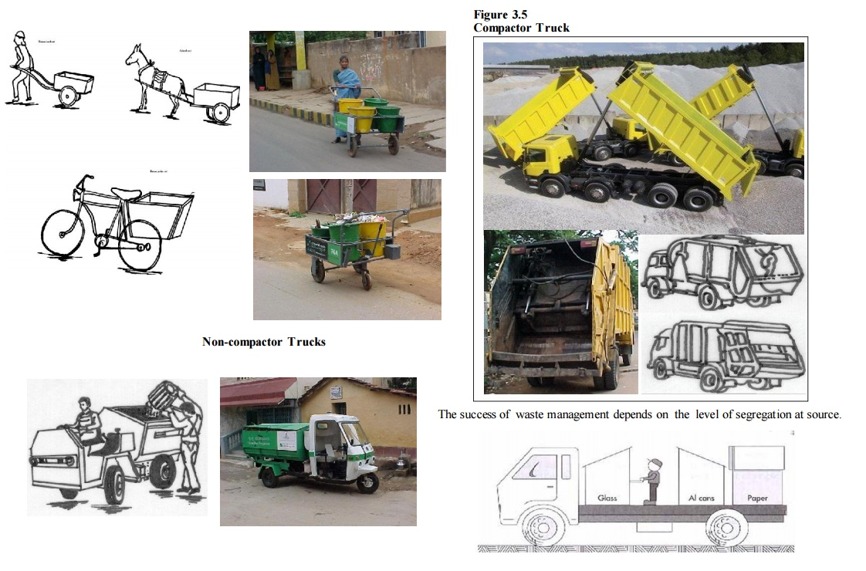
COLLECTION COMPONENTS
Collection points: These affect such collection system components as crew size and storage, which ultimately control the cost of collection. Note that the collection points depend on locality and may be residential, commercial or industrial.

Slide 13
COLLECTION COMPONENTS
Collection frequency: Climatic conditions and requirements of a locality as well as containers and costs determine the collection frequency. In hot and humid climates, for example, solid wastes must be collected at least twice a week, as the decomposing solid wastes produce bad odour and leachate. And, as residential wastes usually contain food wastes and other putrescible (rotting) material, frequent collection is desirable for health and aesthetic reasons.
While deciding collection frequency, therefore, you must consider the following: cost, e.g., optimal collection frequency reduces the cost as it involves fewer trucks,
Employees and reduction in total route distance; storage space
Sanitation, e.g., frequent collection reduces concerns about health, safety and nuisance associated with stored refuse.

Slide 14
COLLECTION COMPONENTS
(iii) Storage containers: Proper container selection can save collection energy, increase the speed of collection and reduce crew size. Most importantly, containers should be functional for the amount and type of materials and collection vehicles used. Containers should also be durable, easy to handle, and economical, as well as resistant to corrosion, weather and animals. In residential areas, where refuse is collected manually, standardised metal or plastic containers are typically required for waste storage.

Slide 15
COLLECTION COMPONENTS
(iv) Collection crew : The optimum crew size for a community depends on labour and equipment costs, collection methods and route characteristics. The size of the collection crew also depends on the size and type of collection vehicle used, space between the houses, waste generation rate and collection frequency.
An effective collection crew size and proper workforce management can influence the productivity of the collection system. The crew size, in essence, can have a great effect on overall collection costs.
However, with increase in collection costs, the trend in recent years is towards: decrease in the frequency of collection; increase in the dependence on residents to sort waste materials; increase in the degree of automation used in collection. This trend has, in fact, contributed to smaller crews in municipalities.

Slide 16
COLLECTION COMPONENTS
(v) Collection route : The collection programme must consider the route that is efficient for collection. An efficient routing of Waste Collection, Storage and Transport collection vehicles helps decrease costs by reducing the labour expended for collection. Proper planning of collection route also helps conserve energy and minimise working hours and vehicle fuel consumption.
(vi) Transfer station : A transfer station is an intermediate station between final disposal option and collection point in order to increase the efficiency of the system, as collection vehicles and crew remain closer to routes. If the disposal site is far from the collection area, it is justifiable to have a transfer station, where smaller collection vehicles transfer their loads to larger vehicles, which then haul the waste long distances. In some instances, the transfer station serves as a pre-processing point, where wastes are dewatered, scooped or compressed.

Slide 17
WASTE COLLECTION METHOD
The waste collection process contains the way from filling of containers to loading of the collection
vehicle.
A variety of residential, commercial, and industrial development, it is impossible to collect waste with just one system.
A variety of collection systems are used that respective municipal requirements to be used accordingly.
Each collection method has compatible container systems and vehicles with dedicated loaders.
Simple Emptying Method
Exchange Method
One-Way Method
Non-systematic Collection
Special Collection Systems
Other Collection Systems

Slide 18
SIMPLE EMPTYING METHOD:
The Simple Emptying Method is used for the removal of household and small-scale commercial
waste with mobile containers which are drained at the consumer.
A lot of different standardized containers are used.
These containers are emptied by combination top-loaders that can pick up many different container sizes.
Some container systems have been modernized to include self-compactors.
With this system it is possible to charge 2 to 3 times to container volume.

Slide 19
Exchange Method:
WASTE COLLECTION METHOD
At this method, full containers are exchanged with empty containers at their location.
This method is suitable for high sensitivity waste, e.g. construction debris and sludge, as well as for low density waste from institutions or large hotels.
Because of economy, these containers have minimum capacities of 4 m3.
One-Way Method:
In the one-way method, waste is picked up in clear plastic or paper bags whose volume is limited to a maximum of 110 L.
The bags are picked up by hand, so there are no emptied containers to be returned to the curb and the containers are not cleaned.

Slide 20
WASTE COLLECTION METHOD
NON-SYSTEMATIC COLLECTION:
The non-systematic collection method is used for collecting bulky waste or extra large particles, e.g. bulky goods.

Slide 21
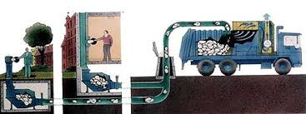
WASTE COLLECTION METHOD
Special Collection Systems:
Vacuum extraction and hydraulic flushing are two kinds of special collection systems.
Both the pneumatic vacuum transport systems and the hydraulic flushing method combine collection and transport processes, but they have low importance.

Slide 22
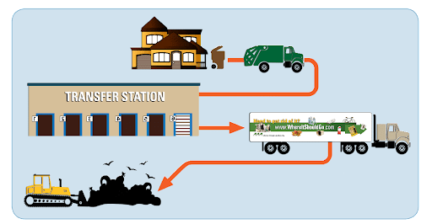
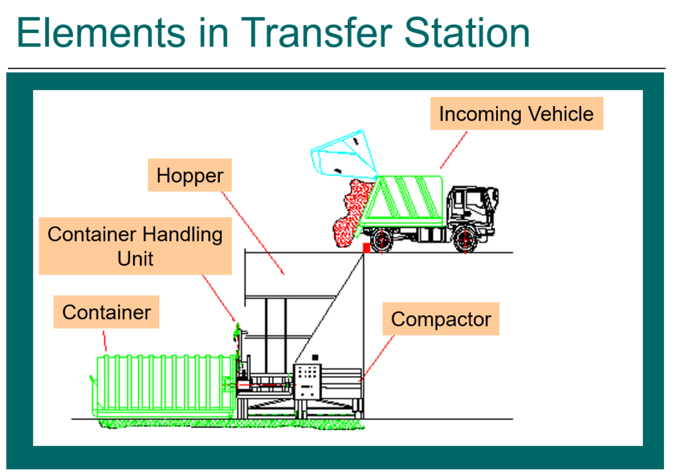

TRANSFER STATION
A transfer station is a building or processing site for the temporary deposition of waste.
Transfer stations are often used as places where local waste collection vehicles will deposit their waste cargo prior to loading into larger vehicles.

Slide 23
FACTORS AFFECTING THE SELECTION OF A TRANSFER STATION
Types of waste received.
Processes required in recovering material from wastes.
Required capacity and amount of waste storage desired.
Types of collection vehicles using the facility.
Types of transfer vehicles that can be accommodated at the disposal facilities.
Site topography and access.
The main problem in the establishment of a transfer station, however, is securing a suitable site. Stored solid wastes and recyclable materials, if not properly handled, will attract flies and other insect vectors. Odours from the transferred solid wastes will also be a nuisance, if not properly controlled. In addition, the traffic and noise due to small and large collection vehicles, collectors, drivers, etc.

Slide 24
TYPES OF TRANSFER STATION
Small to medium transfer stations
Large transfer stations
Small to medium transfer stations:
These are direct-discharge stations that provide no intermediate waste storage area.
The capacities are generally small (less than 100 tonnes/day) and medium (100 to 500 tonnes/day). Depending on weather, site aesthetics and environmental concerns, transfer operations of this size may be located either indoor or outdoor.
More complex small transfer stations are usually attended during hours of operation and may include some simple waste and materials processing facilities. For example, it includes a recyclable material separation and processing centre.
The required overall station capacity (i.e., the number and size of containers) depends on the size and population density of the area served and the frequency of collection.

Slide 25
TYPES OF TRANSFER STATION
Large Transfer stations:
These are designed for heavy commercial use by private and municipal collection vehicles. The typical operational procedure for a larger station is as follows:
when collection vehicles arrive at the site, they are checked in for billing, weighed and directed to the appropriate dumping area.
collection vehicles travel to the dumping area and empty the wastes into a waiting trailer, a pit or a platform.
after unloading, the collection vehicle leaves the site, and there is no need to weigh the departing vehicle, if its weight (empty) is known.
Transfer vehicles are weighed either during or after loading. If weighed during loading, trailers can be more consistently loaded to just under maximum legal weights and this maximizes payloads and minimises weight violations.

Slide 26
DESIGNS FOR LARGER TRANSFER OPERATIONS
Several different designs for larger transfer operations are common, depending on the transfer distance and vehicle type. Most designs, however, fall into one of the following three categories:
Direct-discharge non-compaction station:
In these stations, waste is dumped directly from collection vehicle into waiting transfer trailers and is generally designed with two main operating floors.
In the transfer operation, wastes are dumped directly from collection vehicles (on the top floor) through a hopper and into open top trailers on the lower floor.
The trailers are often positioned on scales so that dumping can be stopped when the maximum payload is reached.
A stationary crane with a bucket is often used to distribute the waste in the trailer. After loading, a cover or tarpaulin is placed over the trailer top.
However, some provision for waste storage during peak time or system interruptions should be developed. Because of the use of little hydraulic equipment, a shutdown is unlikely and this station minimizes handling of waste.

Slide 27
PLATFORM/PIT NON-COMPACTION STATION:
In this arrangement, the collection vehicles dump their wastes onto a platform or into a pit using waste handling equipment, where wastes can be temporarily stored, and if desired, picked through for recyclables or unacceptable materials.
The waste is then pushed into open-top trailers, usually by front-end loaders. Like direct discharge stations, platform stations have two levels. If a pit is used, however, the station has three levels.
A major advantage of these stations is that they provide temporary storage, which allows peak inflow of wastes to be levelled out over a longer period.
Construction costs for this type of facility are usually higher because of the increased floor space. This station provides convenient and efficient storage area and due to simplicity of operation and equipment, the potential for station shutdown is less.

Slide 28
PLATFORM/PIT NON-COMPACTION STATION:
Compaction station:
In this type of station, the mechanical equipment is used to increase the density of wastes before they are transferred.
The most common type of compaction station uses a hydraulically powered compactor to compress wastes.
Wastes are fed into the compactor through a chute, either directly from collection trucks or after intermediate use of a pit.
The hydraulic ram of the compactor pushes waste into the transfer trailer, which is usually mechanically linked to the compactor (EPA, 1995). Compaction stations are used when:
wastes must be baled for shipment;
open-top trailers cannot be used because of size restrictions;
site topography or layout does not accommodate a multi-level building.

Slide 29
COLLECTION OPERATION
MOVEMENT OF COLLECTION CREW:
In cultures such as India, Bangladesh, etc., solid waste collection is assigned to the lowest social group.
More often, the collection crew member accepts the job as a temporary position or stopgap arrangement, while looking for other jobs that are considered more respectable.
Apart from this cultural problem, the attitude of some SWM authorities affects collection operation.
For example, some authorities still think that the collection of solid waste is mechanical, and therefore, the collection crew does not need any training to acquire special skills.
As a result, when a new waste collector starts working, he or she is sent to the field without firm instruction concerning his or her duties, responsibilities and required skills.
For an effective collection operation, the collection team must properly be trained.
The collection crew and the driver of the collection vehicle must, for example, work as a team, and this is important to maintain the team morale and a sense of social responsibility among these workers.

Slide 30
COLLECTION OPERATION
You must also note that the movement of collection crew, container location and vehicle stopping point affect collection system costs.
Figure highlights the distance the collection crew will have to walk, if it were to serve the farthest point first or serve the point closest to the vehicle

Slide 31
COLLECTION OPERATION
The difference may be one or two minutes per collection stop, but it matters with the number of stops the crew will take in a working shift. Multiplying the minutes by the total number of crew working and labour cost depicts the amount of labour hours lost in terms of monetary value.
Generally, familiarity of the crew with the collection area improves efficiency. For example, the driver becomes familiar with the traffic jams, potholes and other obstructions that he or she must avoid.
The crew is aware of the location of the containers and the vehicle stops. It is, therefore, important to assign each crew specific areas of responsibility.
Working together also establishes an understanding of the strong and weak points of the team members and efficient work sequences.
The collection operation must also observe a strict time schedule. Testing of new routes, new gadgets and vehicles is best carried out first in the laboratory and later in a pilot area.
Testing of a new sequence using the whole service area could result in disorder and breakdown of the solid waste collection system. Studies show that it takes two hours to recover for every hour of a failed system.

Slide 32
COLLECTION OPERATION
Motion time measurement (MTM) technique :
Motion time measurement (MTM) studies are now an integral part of the standard procedure in the development of solid waste collection systems.
MTM is a technique to observe and estimate the movement of the collection crew with the help of stopwatches.
The results thus gathered are tabulated to determine the best sequence of activities that workers must follow in order to complete a repetitive task in the shortest possible time.
MTM also helps in deciding the best combination of equipment to maintain a desired level of output, reduce health problems related to the repetitive work sequence and predict the effects of changes in materials handled.
Sophisticated MTM studies involve hidden or open video cameras at different collection stops to record, replay and study the operation sequence of the collection crew.
If the crew is conscious of being observed, they tend to work faster and reduce time wastage in unauthorized salvaging and other non-scheduled activities.

Slide 33
COLLECTION OPERATION
COLLECTION VEHICLE ROUTING:
Efficient routing and re-routing of solid waste collection vehicles can help decrease costs by reducing the labour expended for collection. Routing procedures usually consist of the following two separate components.
Macro-routing:
Macro-routing, also referred to as route-balancing, consists of dividing the total collection area into routes, sized in such a way as to represent a day’s collection for each crew.
The size of each route depends on the amount of waste collected per stop, distance between stops, loading time and traffic conditions.
Barriers, such as railroad embankments, rivers and roads with heavy competing traffic, can be used to divide route territories.
As much as possible, the size and shape of route areas should be balanced within the limits imposed by such barriers.

Slide 34
COLLECTION OPERATION
Micro-routing:
Using the results of the macro-routing analysis, micro-routing can define the specific path that each crew and collection vehicle will take each collection day.
Results of micro-routing analyses can then be used to readjust macro-routing decisions.
Micro-routing analyses should also include input and review from experienced collection drivers.
The heuristic (i.e., trial and error) route development process is a relatively simple manual approach that applies specific routing patterns to block configurations.
The map should show collection, service garage locations, disposal or transfer sites, one-way streets, natural barriers and areas of heavy traffic flow. Routes should then be traced onto the tracing paper using the following rules
Routes should not be fragmented or overlapping. Each route should be compact, consisting of street segments clustered in the same geographical area.
Total collection plus hauling time should be reasonably constant for each route in the community.

Slide 35
COLLECTION OPERATION
The collection route should be started as close to the garage or motor pool as possible, taking into account heavily travelled and one-way streets.
Heavily travelled streets should not be visited during rush hours.
In the case of one-way streets, it is best to start the route near the upper end of the street, working down it through the looping process.
Services on dead-end streets can be considered as services on the street segment that they intersect, since they can only be collected by passing down that street segment.
To keep right turns at a minimum, (in countries where driving is left-oriented) collection from the dead-end streets is done when they are to the left of the truck. They must be collected by walking down, reversing the vehicle or taking a U-turn.
Waste on a steep hill should be collected, when practical, on both sides of the street while vehicle is moving downhill. This facilitates safe, easy and fast collection. It also lessens wear of vehicle and conserves gas and oil.

Slide 36
COLLECTION OPERATION
Higher elevations should be at the start of the route.
For collection from one side of the street at a time, it is generally best to route with many anti-clockwise turns around blocks.
For collection from both sides of the street at the same time, it is generally best to route with long, straight paths across the grid before looping anti-clockwise.

Slide 37
STORAGE: CONTAINERS/COLLECTION VEHICLES
As mentioned in Unit 1, waste storage is an important component of a waste management system. Waste storage encompasses proper containers to store wastes and efficient transport of wastes without any spillage to transfer stations/disposal sites. We will analyze these two aspects of waste storage.
Containers/storage bin
Collection vehicles

Slide 38
STORAGE: CONTAINERS/COLLECTION VEHICLES
The design of an efficient waste collection system requires careful consideration of the type, size and location of containers at the point of generation for storage of wastes until they are collected.
While single-family households generally use small containers, residential units, commercial units, institutions and industries require large containers. Smaller containers are usually handled manually whereas the larger, heavier ones require mechanical handling. The containers may fall under either of the following two categories:
Stationary containers:
These are used for contents to be transferred to collection vehicles at the site of storage.
Hauled containers:
These are used for contents to be directly transferred to a processing plant, transfer station or disposal site for emptying before being returned to the storage site.

Slide 39
STORAGE: CONTAINERS/COLLECTION VEHICLES
The desirable characteristics of a well-designed container are low cost, size, weight, shape, resistance to corrosion, water tightness, strength and durability.
For example, a container for manual handling by one person should not weigh more than 20 kg, lest it may lead to occupational health hazards such as muscular strain, etc.
Containers that weigh more than 20 kg, when full, require two or more crew members to manually load and unload the wastes, and which result in low collection efficiency.
Containers should not have rough or sharp edges, and preferably have a handle and a wheel to facilitate mobility.
They should be covered to prevent rainwater from entering (which increases the weight and rate of decomposition of organic materials) into the solid wastes.
The container body must be strong enough to resist and discourage stray animals and scavengers from ripping it as well as withstand rough handling by the collection crew and mechanical loading equipment.
Containers should be provided with a lifting bar, compatible with the hoisting mechanism of the vehicle.
The material used should be light, recyclable, easily moulded and the surface must be smooth and resistant to corrosion.

Slide 40
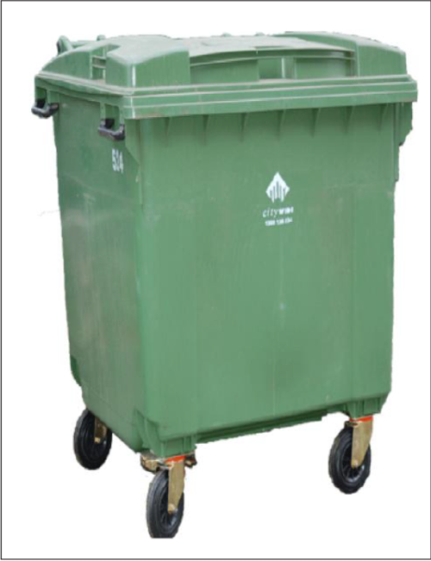
STORAGE: CONTAINERS/COLLECTION VEHICLES
Generally, the containers used for waste storage are communal/public containers. Figure below shows a typical communal container, which a compactor collection vehicle can lift and empty mechanically.
The use of communal containers is largely dependent on local culture, tradition and attitudes towards waste. Communal containers may be fixed on the ground (stationary) or movable (hauled).
Movable containers are provided with hoists and tails compatible with lifting mechanism of collection vehicles and such containers have capacities of 1 – 4 m3. The waste management authority must monitor, maintain and upgrade the communal containers. Note that in residential and commercial areas in India, the communal containers are often made of concrete.

Slide 41
STORAGE: CONTAINERS/COLLECTION VEHICLES
Almost all collections are based on collector and collection crew, which move through the collection service area with a vehicle for collecting the waste material.
The collection vehicle selected must be appropriate to the terrain, type and density of waste generation points, the way it travels and type and kind of material.
Small-scale collection and muscle-powered vehicles
Non-compactor trucks
Compactor truck

Slide 42
STORAGE: CONTAINERS/COLLECTION VEHICLES
Small-scale collection and muscle-powered vehicles:
These are common vehicles used for waste collection in many countries and are generally used in rural hilly areas.
As Figure illustrates, these can be small rickshaws, carts or wagons pulled by people or animals, and are less expensive, easier to build and maintain compared to other vehicle.
They are suitable for densely populated areas with narrow lanes, and squatter settlements, where there is relatively low volume of waste generated. Some drawbacks of these collection vehicles include limited travel range of the vehicles and weather exposure that affect humans and animals.

Slide 43
STORAGE: CONTAINERS/COLLECTION VEHICLES
Non-compactor trucks:
Non-compactor trucks are efficient and cost effective in small cities and in areas where wastes tend to be very dense and have little potential for compaction. Figure illustrates a non-compactor truck When these trucks are used for waste collection, they need a dumping system to easily discharge the waste.
It is generally required to cover the trucks in order to prevent residue flying off or rain soaking the wastes. Trucks with capacities of 10 – 12 m3 are effective, if the distance between the disposal site and the collection area is less than 15 km.
If the distance is longer, a potential transfer station closer than 10 km from the collection area is required. Non-compactor trucks are generally used, when labour cost is high. Controlling and operating cost is a deciding factor, when collection routes are long and relatively sparsely populated.

Slide 44
STORAGE: CONTAINERS/COLLECTION VEHICLES
Compactor truck:
Compaction vehicles are more common these days, generally having capacities of 12 – 15 m3 due to limitations imposed by narrow roads. Although the capacity of a compaction vehicle, illustrated in Figure 3.4, is similar to that of a dump truck, the weight of solid wastes collected per trip is 2 to 2.5 times larger since the wastes are hydraulically compacted
The success of waste management depends on the level of segregation at source. One of the examples for best collection method is illustrated in the figure below

Slide 45
STORAGE: CONTAINERS/COLLECTION VEHICLES
Compactor truck:
A compactor truck allows waste containers to be emptied into the vehicle from the rear, front or sides and inhibits vectors (of disease) from reaching the waste during collection and transport. It works poorly when waste containers are uniform, large, covered and relatively visually inoffensive;
waste is set out in containers so that the crew can pick them up quickly;
health risk to the collectors and odor on the streets are minimized;
waste is relatively inaccessible to the waste pickers.

Slide 46

CAPACITY AND VIABILITY OF TRANSFER STATIONS
A transfer station should have enough capacity to manage and handle the wastes at the facility throughout its operating life.
While selecting the design capacity of a transfer station, we must, therefore, consider trade-offs between the capital costs associated with the station and equipment and the operational costs.
Designers should also plan adequate space for waste storage and, if necessary, waste processing.
Transfer stations are usually designed to have 1.5 – 2 days of storage capacity.
To minimize the space required, the facility should be designed such that the collection vehicle backs into the unloading position.
Adequate space should also be available for offices, employee facilities, and other facility-related activities (EPA, 1995).

Slide 47
CAPACITY AND VIABILITY OF TRANSFER STATIONS
Factors that should be considered in determining the appropriate capacity of a transfer facility include:
Capacity of collection vehicles using the facility;
Desired number of days of storage space on tipping floor;
Time required to unload collection vehicles;
Number of vehicles that will use the station and their expected days and hours of arrival;
Waste sorting or processing to be accomplished at the facility;
Transfer trailer capacity; hours of station operation;
Availability of transfer trailers waiting for loading;
Time required, if necessary, to attach and disconnect trailers from tractors or compactors.

Slide 48
WASTE COLLECTION SYSTEM DESIGN
After the identification of appropriate options for collection, equipment and transfer, the various combinations of these elements to define system-wide alternatives for further analysis has to be examined.
Each should be evaluated for its ability to achieve the identified goals of the collection programme.
Economic analysis will usually be a central focus of the system evaluation.

Slide 49
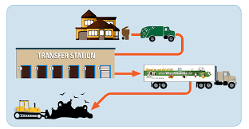
WASTE COLLECTION SYSTEM DESIGN

Slide 50
WASTE COLLECTION SYSTEM DESIGN
This initial evaluation will lead to several iterations, with the differences between the alternatives under consideration becoming more narrowly focused with each round of evaluations
After comparing the alternative strategies, the various elements like crew and truck requirement, time requirement and cost involved are calculated.

Slide 51
WASTE COLLECTION SYSTEM DESIGN
The various formulae used to calculate are:
(i) Number of services/vehicle load (N):
N = (C x D)/W where, C = Vehicle capacity (m3 ); D = Waste density (kg/m3 ) and W = Waste generation/residence (kg/service)
(ii) Time required collecting one load (E):
E = N x L where, L = Loading time/residence, including on-route travel
(iii) Number of loads/crew/day (n):
The number of loads (n) that each crew can collect in a day can be estimated based on the workday length (t), and the time spent on administration and breaks (t1), time for hauling and other travel (t 2) and collection route time (t3).

Slide 52
WASTE COLLECTION SYSTEM DESIGN
The various formulae used to calculate are:
Administrative and break time (t1):
t1 = A + B where, A = Administrative time (i.e., for meetings, paperwork, unspecified slack time) and
B = Time for breaks and lunch
Hauling and other travel time (t2):
t2 = (n x H) - f + G + J where, n = Number of loads/crew/day; H = Time to travel to disposal site, empty truck, and return to route; f = Time to return from site to route; G = Time to travel from staging garage to route and J = Time to return from disposal site to garage.
Time spent on collection route (t3):
t3 = n x E where variables have been previously defined.
Length of workday (t):
t = t1 + t2 +t3 where t is defined by work rules and equations A through D are solved to find n.

Slide 53
WASTE COLLECTION SYSTEM DESIGN
(iv) Calculation of number of vehicles and crews (K):
K = (S x F)/(N x n x M) where, S = Total number of services in the collection area; F = Frequency of collection (numbers/week) and M = Number of workdays/week
(v) Calculation of annual vehicle and labour costs:
Vehicle costs = Depreciation + Maintenance + Consumables + Overhead + License + Fees + Insurance Labour costs + Drivers salary + Crew salaries + Fringe benefits + Indirect labour + Supplies + Overhead

Slide 54
RECORD KEEPING, CONTROL, INVENTORY AND MONITORING
For effective waste collection and, indeed, SWM, we must maintain records on the quantities of wastes collected and their variation within a week, month and year, as well as on established long-term trends in solid waste generation rates
and composition, sources of wastes and the personnel collecting them. Long-term trends in solid waste generation rates and composition form the basis for planning, especially in budgeting for future vehicle requirements, allocating the collection vehicles and crew, building transfer stations, acquiring strategic lands and determining disposal options.

Slide 55


RECORD KEEPING, CONTROL, INVENTORY AND MONITORING
Components | Factors to Consider
Crew size | labour cost distance between containers size and types of containers loading accessories available in the truck collection vehicle used
Container type | solid wastes generation rate density of waste generation street width traffic volume collection crew configuration standard of living
Collection accessory | labour cost protection of worker’s health
Vehicle size/type | street width, traffic volume solid waste generation rates crew size viability of a transfer station
Collection route | street width, traffic volume direction of traffic flow solid waste generation rates spatial distribution of wastes local topography
Transfer station | distance between disposal site and collection area hauling cost for small and large trucks cost of transferring the solid wastes from small to large trucks
Table below contains an illustration of a checklist of factors that affect the waste collection system:

Slide 56
RECORD KEEPING, CONTROL, INVENTORY AND MONITORING
Records of personnel and quantities of wastes collected are, when maintained, useful in determining the efficiency of the personnel and in correlating waste quantities with conditions in the service area.
A time keeping system at the transfer or disposal site is a key element in improving the efficiency of collection system and planning an upgraded system.
The timekeeping system determines if the crew were taking long rest periods, spending time salvaging or carrying out unauthorized activities.
The performance of a particular crew in terms of the quantity of solid wastes collected per day could be compared with that of another collection crew working under similar conditions.

Slide 57
IMPLEMENTING COLLECTION AND TRANSFER SYSTEM
Implementing of collection and transfer system involves the following activities, which are important for success of the plan .
(i) Finalizing and implementing the system management plan:
For proper implementation of collection and transfer system, it is necessary to have clear organizational structures and management plans.
The organizational structure should be simple, with a minimum of administrative and management layers between collection crews and top management. All workers in the department should clearly understand the department’s mission and their roles.

Slide 58
IMPLEMENTING COLLECTION AND TRANSFER SYSTEM
(ii) Purchasing and managing equipment: For purchasing equipment, most municipalities issue bid specifications.
Detailed specifications include exact requirements for equipment sizes and capacities, power ratings, etc. Performance specifications often request that equipment be equivalent to certain available models and meet standards for capacity, speed, etc.

Slide 59
IMPLEMENTING COLLECTION AND TRANSFER SYSTEM
In addition, each vehicle should have an individual maintenance record that includes the following items:
preventive maintenance schedule;
current list of specific engine;
a description of repairs and a list containing information on the repair date, mechanic, cost, type and manufacturer of repair parts and the length of time the truck was out of service, for each maintenance event.

Slide 60
IMPLEMENTING COLLECTION AND TRANSFER SYSTEM
(iii) Hiring and training personnel: As in all organizations, good personnel management is essential to an efficient, high-quality waste collection system. Authorities responsible for SWM should, therefore, strive to hire and keep well-qualified personnel.
(iv) Providing public information: Maintaining good communication with the public is important to a well-run collection system. Residents can greatly influence the performance of the collection system by co-operating in separation requirements, and by keeping undesirable materials from entering the collected waste stream.

Slide 61
IMPLEMENTING COLLECTION AND TRANSFER SYSTEM
(v) Monitoring system cost and performance: Collection and transfer facilities should develop and maintain an effective system for cost and performance reporting. Each collection crew should complete a daily report containing the following information:
Total quantity hauled. Total distance and travel times to and from the disposal site.
Amounts delivered to each disposal, transfer, or processing facility.
Waiting time at sites. Number of loads hauled. Vehicle or operational problems needing attention

